Slide 1
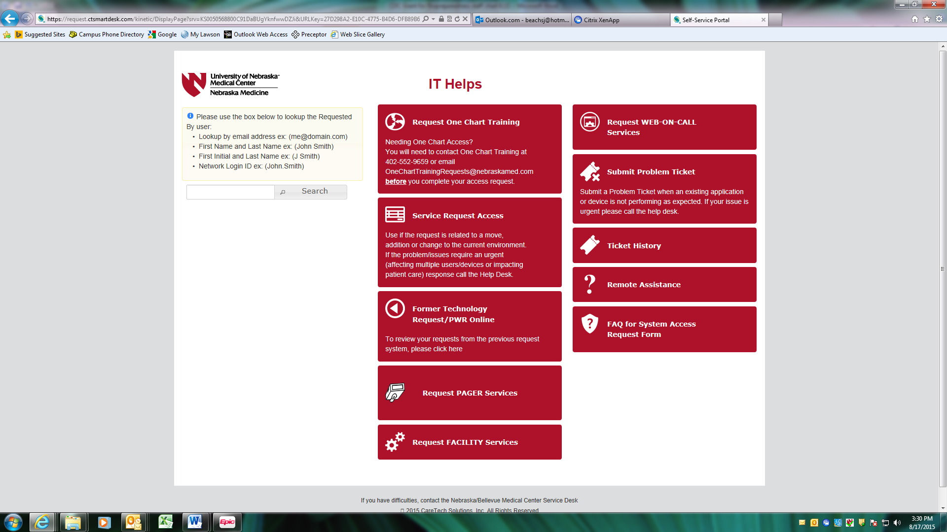
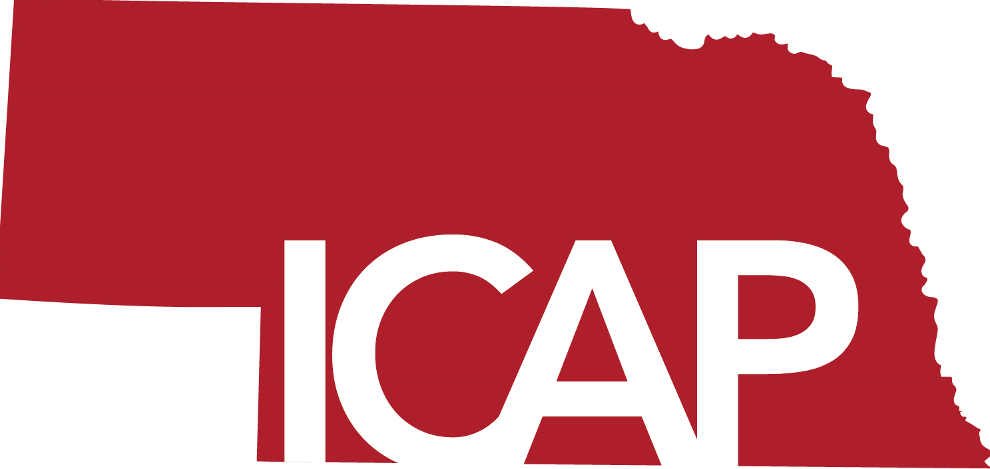

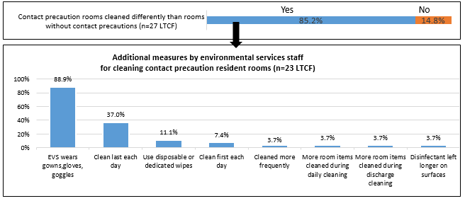
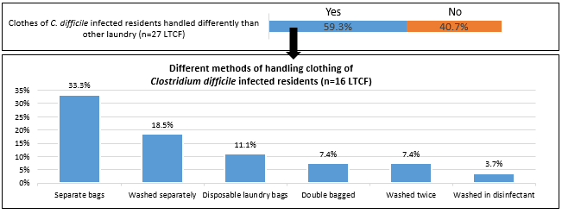
Environmental Cleaning and Disinfection Policies, Protocols and Practices:
A Survey of 27 Long-Term Care Facilities
Muhammad Salman Ashraf, MBBS^{2,5,} Regina Nailon PhD, RN ^{1,2}, Susan Huang, MD MPH ³, Sue Beach, BA ^{1,2}, Margaret Drake, MT, ASCP, CIC^{1,2,4,} Teresa Fitzgerald, RN, BSN, CIC ^{1,2}, Teresa A. Micheels, MSN, RN, CIC ^{1,2}, Elizabeth R Lyden, MS ⁵, Michelle Schwedhelm, MSN, RN, NEA-BC ^{1,2}, Maureen Tierney, MD, MSc ^{2,4} ,L. Kate Tyner, BSN, RN ^{1,2}, Mark E. Rupp, MD^{1,2,6},
1.Nebraska Medicine 2.Nebraska Infection Control Assessment & Promotion Program. 3.Division of Infectious Diseases and Health Policy Research
Institute, University of California, Irvine School of Medicine, Irvine, CA, 4.Nebraska DPH Division of Epidemiology 5.University of Nebraska Medical Center, College of Public Health, 6.Division of Infectious Diseases, Department of Internal Medicine, University of Nebraska Medical Center
Contact Information:
M. Salman Ashraf, MBBS
985400 Nebraska Medical Center
Omaha, NE 68198-5400
Salman.ashraf@unmc.edu
BACKGROUND
Effective environmental cleaning and disinfection (ECD) practices can decrease healthcare-associated infection risk but there are limited data regarding ECD in long-term care facilities (LTCF).
Hence, we conducted a survey to study ECD practices in LTCF.
METHODS
On-site interviews with infection preventionists (IP) and environmental services (EVS) managers were conducted in 27 LTCF across Nebraska using a 45-question survey tool.
The survey assessed baseline characteristics, written ECD policies and protocols, routine ECD processes, and special ECD measures when dealing with suspected or confirmed drug-resistant organisms.
Responses were analyzed to identify variations among the LTCF.
Fisher’s exact and Mann Whitney tests were used as appropriate to study whether bed size, hospital affiliation, presence of IP trained in infection control (IC), or IPs spending >8 hours/ week on IC activities were associated with variations in ECD policies and protocols among facilities.
RESULTS
EVS staff in most LTCF were facility-employed but some had outside agency contracts (Table 1).
74.1% LTCF reported having written policies and procedures consistent with actual practices of ECD.
48.1% of LTCF review and update policies with infection preventionists’ input on a yearly basis.
Most high touch surfaces in the resident rooms are routinely cleaned and disinfected daily in >80% LTCF, but fewer facilities report the same for common areas (Table 2).
Variations exist in several other processes including ECD of contact precaution rooms (Figure 1) and procedures related to C. difficile infection (Figure 2).
Table 3 highlights some additional practice variations.
No statistically significant association was found between studied variables and policy and protocol variations, but some trends were identified (Table 4).
Hospital affiliation and 8 or more weekly hours devoted by IP towards infection control activities have a weak association with the presence of certain policies and protocols (Table 4).
Table 2. Proportion of LTCF with reported daily cleaning of high touch surfaces in resident rooms and common areas.
Table 4. Policies and protocols associations with facility characteristics.
High touch surface in resident rooms | % Cleaned
Exterior Room Door Handle (n=27) | 96%
Interior Room Door Handle (n=27) | 93%
Light Switches (n=27) | 89%
Bedside Table (n=26) | 88%
Nurse Call Box (n=27) | 85%
Bed Handle Rails (n=21) | 71%
Resident Chair (n=25) | 52%
High touch surface in common areas | % Cleaned
Craft Room Tables (n=25) | 80%
End Tables (n=25) | 80%
Chair Handles/ Arms (n=27) | 74%
Phones (n=16) | 69%
Grab Bars/Hallway Railings (n=27) | 63%
Remote Controls (n=23) | 61%
Chairs (n=27) | 44%
Number of facilities with presence of specific ECD policy and protocol (n=Number of facilities with particular policy in place out of 27 LTCF) | Frequency of hospital affiliation for LTCF with corresponding policy | Frequency of hospital affiliation for LTCF without corresponding policy | p value | Frequency of >8 weekly IP hours in LTCF with corresponding policy | Frequency of > 8 weekly IP hours in LTCF without corresponding policy | p value
Written policy and procedure consistent with actual practices (n=20) | 5 (25%) | 1 (14%) | 1.0 | 10 (50%) | 3 (43%) | 1.0
Policies and procedures reviewed annually with input of infection preventionist (n=13) | 5 (38%) | 1 (7%) | 0.07 | 7 (54%) | 6 (43%) | 0.7
Competency validation is performed after training at hire and documentation is maintained (n=19) | 3 (16%) | 3 (38%) | 0.3 | 8 (42%) | 5 (63%) | 0.4
Annual training/continuing education is performed along with competency validation (n=12) | 5 (42%) | 1 (7%) | 0.06 | 6 (50%) | 7 (47%) | 0.4
EVS staff get educated on facility’s infection control policies at hire and annually (n=15) | 5 (33%) | 1 (8%) | 0.2 | 10 (67%) | 3 (25%) | 0.05
Blood-borne pathogen training with competency validation is provided upon hire and annually (n=19) | 3 (16%) | 3 (38%) | 0.3 | 8 (42%) | 5 (53%) | 0.4
Proper use of PPE training and competency validation performed at hire and annually (n=12) | 1 (8%) | 5 (33%) | 0.2 | 5 (42%) | 8 (53%) | 0.7
Audits are conducted to examine the quality of cleaning and records are maintained (n=18) | 6 (33%) | 0 | 0.07 | 10 (56%) | 3 (33%) | 0.4
Feedback is provided to EVS staff on cleaning audits and records of feedback are maintained (n=14) | 5 (35.7%) | 1 (8%) | 0.2 | 8 of 14 (57%) | 5 (38.4%) | 0.4
Table 3. Examples of practice variations among surveyed long-term care facilities.
Environmental cleaning and disinfection practices | Responses % Yes
Disinfectants commonly used by EVS staff at the facility Diluted bleach Quaternary ammonium agent Hydrogen Peroxide | 85.2% 55.6% 33.3%
Method of applying disinfectant to cleaning cloths Spray bottle Bucket Immersion | 59.3% 48.1%
High touch surfaces cleaning frequency during influenza season Residents rooms get cleaned more frequently Common area get cleaned more frequently Cleaned at the same frequency as in non-influenza season | 66.7% 33.3% 25.9%
Carpet cleaning/disinfection rooms of residents with suspected CDI No carpet in resident room Carpets get shampooed No special measures taken Additional disinfectant use for cleaning (unspecified) | 51.9% 25.9% 18.5% 7.4%
Frequency of changing residents’ bedding and linens After each episode of incontinence When visibly dirty Weekly Once daily Twice weekly | 70.4% 66.7% 48.1% 25.9% 22.2%
Cleaning procedure for dishes used by resident with C. difficile infection Same as for everyone else Disposable items are used Dishes get bagged and handled separately Different but unspecified procedure for handling | 51.9% 33.3% 7.4% 7.4%
Cleaning frequency of the carts Once daily Once a week After end of each shift Do not know | 29.6% 29.6% 25.9% 7.4%
Table 1. Demographic information of surveyed long-term care facilities.
.
Figure 1. Variations in cleaning and disinfection processes for rooms of residents with contact precautions in place.
 | Facility with < 100 beds N = 21 | Facility with >100 beds N = 6
Number (%) of LTCF affiliated with hospital | 5 (24%) | 1 (17%)
No. of license beds Median Range | 61 8 - 81 | 196 116-293
Estimated proportion of short-term care beds over last one year Median Range | 11% 0 – 100% | 15% 7 - 40%
Rooms All single occupancy room Both single and double occupancy rooms | 3 (14%) 18 (86%) | 0 6 (100%)
Carpets Number (%) of LTCF with carpet in the resident room Number (%) of LTCF with carpet in the common area | 12 (51%) 19 (91%) | 1(14%) 5 (83%)
Estimated Daily Census Median Range | 50 4 - 82 | 153 100 - 231
Infection Preventionist Works only at Nursing Home Works at both NH and affiliated hospital | 20 (95%) 1 (5%) | 6 (100%) 0
Environmental Services Staff NH with all EVS staff from third party agency NH with all EVS staff employed by facility | 0 21 (100%) | 1 (17%) 5 (83%)
Median Number of EVS staff/100 beds Full time Part time | 6.25 5.74 0.82 | 6.42 6.29 0.43
Figure 2. Methods of handling clothing of residents with Clostridium difficile infection.
Note: Text in bold font points toward those differences where p value is <0.1
CONCLUSIONS
ECD policies and practices vary greatly among LTCF, presenting various improvement opportunities.
Development of LTCF-specific ECD guidance may help IPs implement best practices in all LTCF.
REFERENCES
Murphy CR et al. Methicillin-resistant Staphylococcus aureus burden in nursing homes associated with environmental contamination of common areas. J Am Geriatr Soc. 2012 Jun;60(6):1012-8
Reynolds C et al. Methicillin-resistant Staphylococcus aureus (MRSA) carriage in 10 nursing homes in Orange County, California. Infect Control Hosp Epidemiol. 2011 Jan;32(1):91-3.
Ye Z et al. Healthcare-Associated Pathogens and Nursing Home Policies and Practices: Results From a National Survey. Infect Control Hosp Epidemiol. 2015 Jul; 36(7): 759–766.
DISCLOSURES
The authors of this study do not have potential conflict of interests relevant to the content of this poster.

