Slide 1

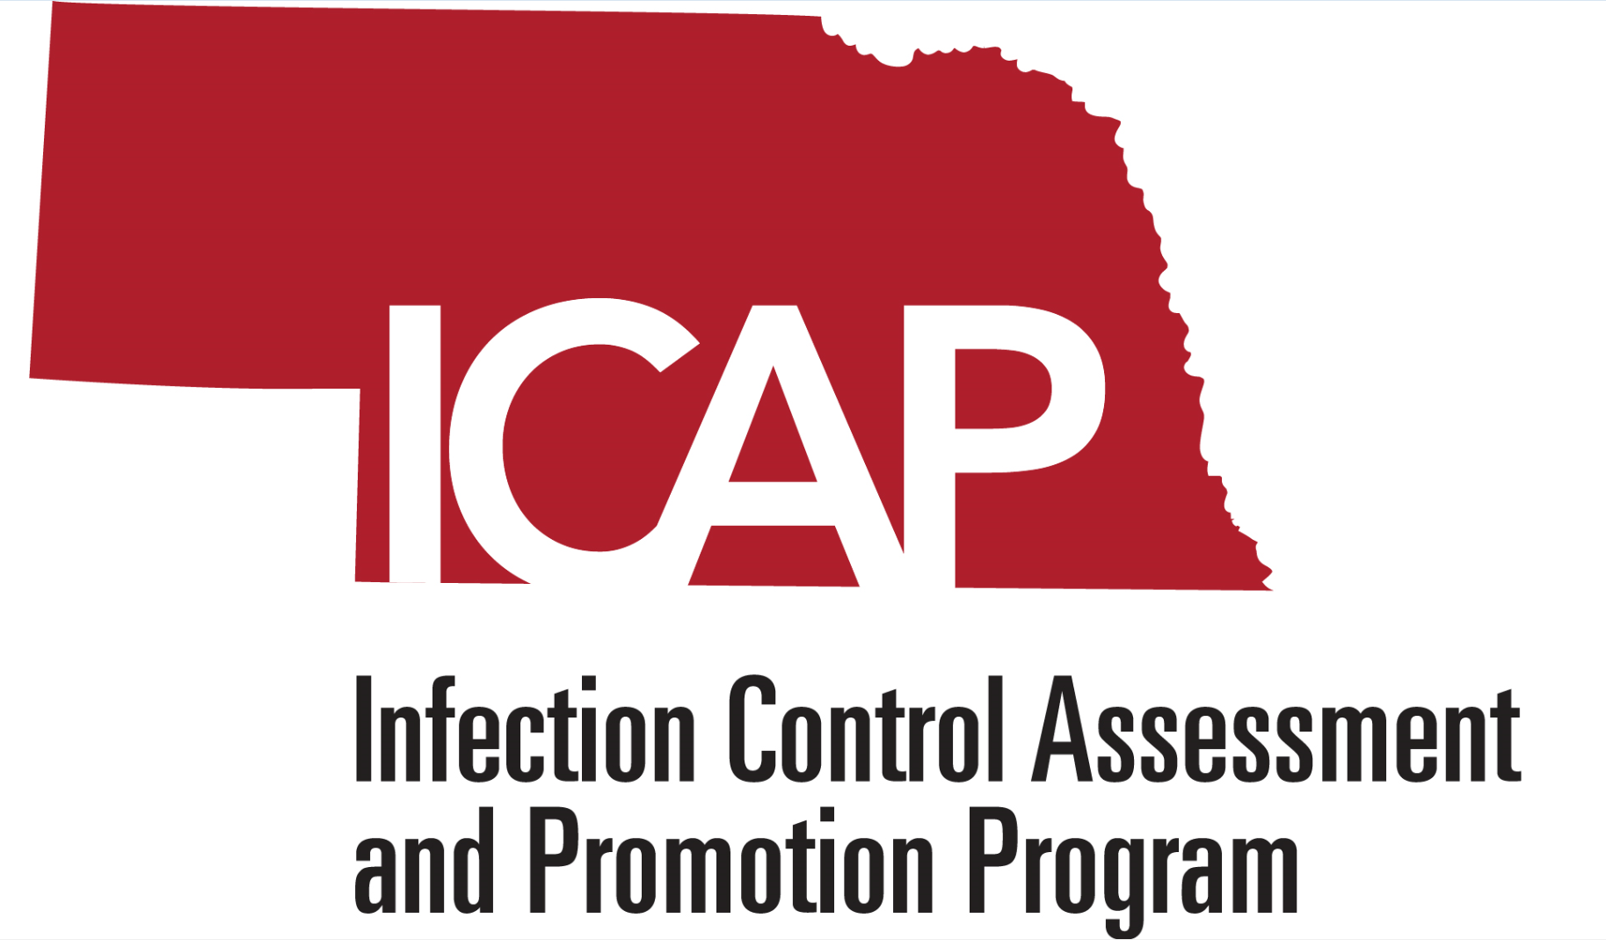

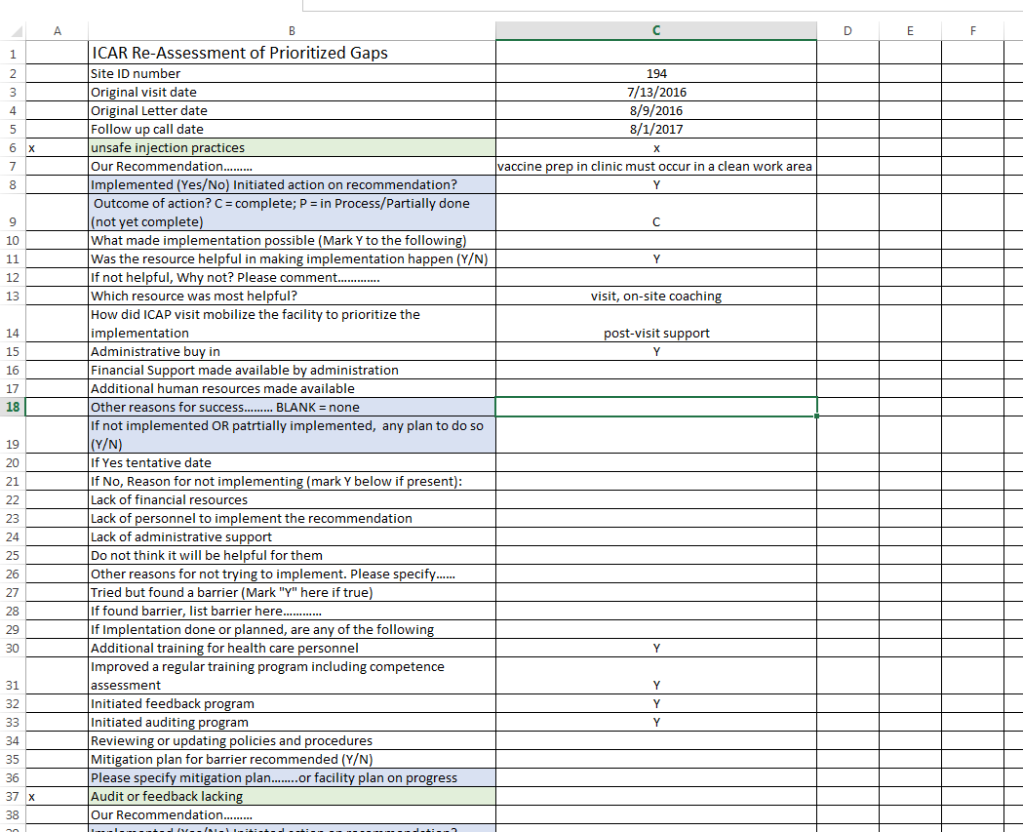
Impact of Infection Control Assessment and Response (ICAR) Team on Infection Control Programs in Acute Care Hospitals in Nebraska
Kate Tyner, BSN, RN,CIC^{1 ,} Teresa Fitzgerald, RN, BSN, CIC^{1,} Regina Nailon, PhD, RN¹, Margaret Drake MT, ASCP, CIC^{1,2}, Teresa Micheels, MSN, RN, CIC^{1,3}, Mark E. Rupp, MD^{1,4},
Michelle Schwedhelm, MSN, RN¹, Maureen Tierney, MD, MSc², Muhammad Salman Ashraf, MBBS^{1,4}
Nebraska Infection Control Assessment Assessment and Promotion Program, Nebraska Medicine, Omaha, NE; (2) Division of Epidemiology, Nebraska Department of Public Health, Lincoln, NE
(3) Infection Control & Epidemiology Department, Nebraska Medicine; (4)Division of Infectious Diseases, University of Nebraska Medical Center
Contact Information :
M. Salman Ashraf
987556 Nebraska Medical Center
Omaha, NE 68198-7556
Salman.ashraf@unmc.edu
BACKGROUND
Table 1. Characteristics of the acute care hospitals visited by the ICAP team
Figure 1. ICAP Role in Facilitating Implementation of Recommendations
Figure 2. Barriers to Complete Implementation of Recommendations
Limited data are available to assess the effectiveness of the Infection Control Assessment and Response (ICAR) program on improving infection prevention (IP) practices in healthcare facilities.
We studied the effectiveness of the Nebraska ICAR team intervention model (peer-to-peer feedback and coaching using evidence-based guidance) on mitigating IP gaps in acute care hospitals (ACH).
Characteristics | N=45
Number (%) CAH (critical access hospital) | 38 (84%)
Number (%) larger hospitals | 7 (15%)
Number (%) hospitals with trained IP | 39 (87%)
Number (%) hospitals with certified IP | 5 (11%)
Infection Preventionists FTE/100 bed in larger facilities: Median (Range) | 1 (0.3– 1)
Infection Preventionists FTE/25 bed in CAH facilities: Median (Range) | 0.42 (0.1 – 1.25)
Bed size: Median (Range) | 23 (10 – 525)
METHODS
Table 2. Summary of recommendations made by the ICAP team
Nebraska ICAR program, also known as Nebraska Infection Control Assessment and Promotion Program (ICAP), works in conjunction with the Nebraska Department of Health and Human Services Healthcare-Associated Infections Program.
Nebraska ICAP conducted on-site assessments of infection control programs in ACH between 11/2015 and 9/2016.
Assessment included use of the CDC Infection Control Assessment Tool for acute care hospitals, Centers for Medicare and Medicaid Infection Control Worksheet 2016, and environmental rounding.
Following the assessments, subject matter experts provided individualized and prioritized evidenced-based recommendations for improvement to each facility based on their identified IP gaps.
Follow-up phone assessments were conducted between 11/2016 and 11/2017 with the ACH infection preventionists one year post visit using a standard questionnaire (Figure 1).
Descriptive analyses were performed to study the impact of the ICAR program in the 32 ACH that received follow-up assessments as of 11/2017 (71% of the total ACH visited).
Description of Recommendations | Number (%)
Number of prioritized recommendations made to 45 acute care hospitals (ACH) that were visited by ICAP | 459
Number of prioritized recommendations made to 32 acute care hospitals that had a follow up call | 268
- Number (%) of recommendations that were implemented | 215 (80%)
-Number (%) of recommendations with complete implementation | 164 (61%)
-Number (%) of recommendations with partial implementation | 51 (19%)
Number of prioritized recommendations that were made to at least 20% of 45 ACH (top recommendations) | 224
Number of top recommendations made to 32 ACH that had a follow-up call | 126
- Number (%) of top recommendations that were implemented | 104 (83%)
-Number (%) of top recommendations with complete implementation | 81 (64%)
-Number (%) of top recommendations with partial implementation | 23 (18%)
Figure 3. Frequent Steps Taken by Facilities to Implement Recommendations
RESULTS
Table 3. Most frequent recommendations given to at least 20% acute care hospitals in 45 acute care hospital site visits
Overall, 45 ACH were assessed (Table 1).
Recommendations ranged from 3 to 21 per ACH (median=9).
Table 2 provides a summary of recommendations made by the ICAP team including the top recommendations (those recommendations that were made to at least 20% of 45 ACH).
The top infection prevention categories which required recommendations for improvement are displayed Table 3.
Of the 16 most frequent recommendations, 12 have been implemented in at least 75% of the facilities with follow up assessment.
ICAP visits and provided resources were the most commonly reported facilitators for implementation of top recommendations (Figure 2).
Lack of staff members/ personnel was the most commonly cited barrier for implementation of those recommendations that were not completely implemented (Figure 3).
Initiation of additional staff training programs was the most commonly reported step taken by hospitals towards implementation of top recommendations (Figure 4).
Top Infection Prevention Categories Requiring Recommendation for Improvement | No. of hospitals with Recommendations | No. of hospitals with follow-up phone assessment | No. (%) of hospitals with complete implementation | No. (%) of hospitals with partial implementation | Overall Implementation rate (complete and partial combined)
Formal hospital infection control risk assessment not done | 22 | 18 | 12 (67%) | 4 (22%) | 89%
Supply & linen storage issues | 20 | 9 | 6 (67%) | 2 (22%) | 89%
High level disinfection process and documentation lacking | 19 | 14 | 13 (93%) | 0 | 93%
Hospital acquired infection surveillance and/ or participation in National Healthcare Safety Network lacking | 18 | 15 | 12 (80%) | 0 | 80%
Audits or feedback lacking | 16 | 7 | 6 (86%) | 0 | 86%
Unsafe injection practices | 14 | 7 | 4 (57%) | 2 (29%) | 86%
Antimicrobial stewardship efforts lacking | 13 | 8 | 3 (38%) | 4 (50%) | 88%
No infection control risk assessment for construction projects or assessment not posted at job sites | 13 | 7 | 3 (43%) | 1 (14%) | 57%
Environmental surfaces are worn and/ or cluttered, not cleanable | 13 | 3 | 0 | 2 (67%) | 67%
Personal protective equipment supplies are scarce and/ or not available at points of use | 11 | 5 | 3 (60%) | 1 (20%) | 80%
Endoscope storage deficient | 11 | 7 | 4 (57%) | 3 (43%) | 100%
Critical equipment reprocessing and/or sterilization issues | 11 | 6 | 3 (50%) | 1 (17%) | 67%
Separation of clean/dirty is not sufficient | 11 | 5 | 2 (40%) | 3 (60%) | 100%
Insufficient number of alcohol- based hand rub dispensers and/ or hand washing sinks | 11 | 6 | 2 (33%) | 0 | 33%
Brushes used during semi-critical instrument reprocessing/ high level disinfection not appropriately cleaned and disinfected | 11 | 4 | 3 (75%) | 0 | 75%
Hand hygiene performed in contaminated sinks | 10 | 5 | 5 (100%) | 0 | 100%
Figure 1. Screenshot for Nebraska ICAP Follow-Up Questionnaire
CONCLUSION
The Nebraska ICAR model for IP gap mitigation, prioritized to the unique needs of the surveyed facilities, resulted in implementation of most recommendations and overall improvement of infection control programs in our state.
DISCLOSURE
The authors have no relevant conflicts of interest with regard to the content of this poster.

