Slide 1
COVID-19 and LTC February 25, 2021
Guidance and responses were provided based on information known on 2/25/2021 and may become out of date. Guidance is being updated rapidly, so users should look to CDC and NE DHHS guidance for updates.

Slide 2
Presentation Information:​
Panelists today are:​
​
​
​
​
​
​
​
​
​
​
​
Slides and a recording of this presentation will be available on the ICAP website:​
https://icap.nebraskamed.com/covid-19-webinars/​
​
Use the Q&A box in the webinar platform to type a question. Questions will be read aloud by the moderator.​
If your question is not answered during the webinar, please either e-mail it to NE ICAP or call during our office hours to speak with one of our IPs.​
​
Dr. Salman Ashraf | salman.ashraf@unmc.edu
Kate Tyner, RN, BSN, CIC | ltyner@nebraskamed.com
Margaret Drake, MT(ASCP),CIC | Margaret.Drake@Nebraska.gov ​
Sarah Stream, MPH, CDA, FADAA Karen Amsberry, MSN, RN | sstream@nebraskamed.com kamsberry@nebraskamed.com
Lacey Pavlovsky, RN, MSN, CIC | lpavlovsky@nebraskamed.com
Dan German | dgerman@nebraskamed.com
Becky Wisell | Becky.Wisell@nebraska.gov
Dan Taylor | Daniel.Taylor@nebraska.gov
Moderated by Marissa Chaney | Machaney@nebraskamed.com ​

Slide 3
Continuing Education Disclosures
1.0 Nursing Contact Hour and 1 NAB Contact Hour is awarded for the LIVE viewing of this webinar​
In order to obtain nursing contact hours, you must be present for the entire live webinar and complete the post webinar survey​
No conflicts of interest were identified for any member of the planning committee, presenters or panelists of the program content​
This CE is hosted Nebraska Medicine along with Nebraska ICAP and Nebraska DHHS​
Nebraska Medicine is approved as a provider of nursing continuing professional development by the Midwest Multistate Division, an accredited approver by the American Nurses Credentialing Center’s (ANCC) Commission on Accreditation

Slide 4
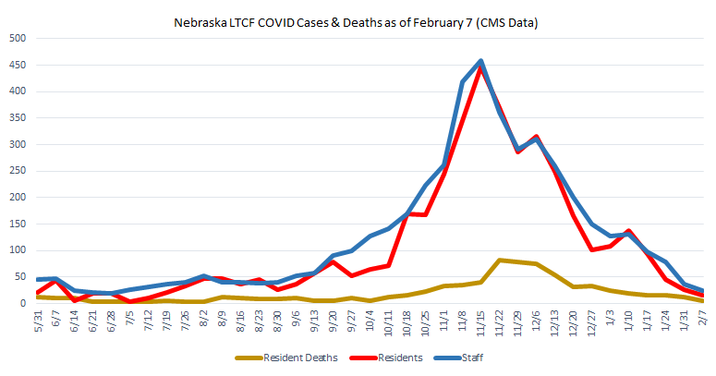
LTCF Resident Weekly COVID Cases
Data source: CMS; Nebraska ICAP Calculations

Slide 5
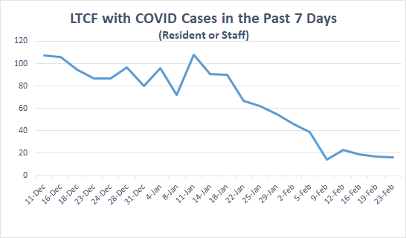

Slide 6
Visitation Updates and Reminders

Slide 7
Important Information from DHHS
Related to Visitation and Vaccine Rate for Assisted Living- Updated 2/18/2021
In light of declining cases of COVID-19 among residents at nursing facilities statewide, and to help further increase access to visitation at ALFs, DHHS leadership would like to update the vaccination threshold recommended for ALF visitation among staff to 75%.
Summary:
For ALFs with >75% staff AND >90% residents vaccinated, we can provide the option to allow increased indoor visitation for vaccinated individuals two weeks after the 75% of staff and 90% of residents received the 2nd dose of vaccine in the series.
This option for increased visitation will be available even for ALFs in red counties.
All other infection control measures must remain in place, including following the Core Principles of COVID-19 Infection Prevention, recommended limitations on the numbers of visitors, and visitation changes in the event of a facility outbreak.

Slide 8
Important Information from DHHS
Related to Visitation and Vaccine Rate for Assisted Living- Updated 2/18/2021
Visitation should continue per standard guidance and all allowances per standard guidance should continue being made.
“Standard guidance” refers to guidance memo QSO 20-39-NH from CMS.
Core Principles of COVID-19 Infection Prevention
Screening of all who enter the facility
Hand hygiene
Face covering or mask
Social distancing
Instructional signage throughout the facility and proper visitor education
Cleaning and disinfecting high frequency touched surfaces
Appropriate staff use of PPE
Effective cohorting of residents
Resident and staff testing
***This updated visitation guidance applies only to ALFs.
Nursing homes that are certified by CMS must continue to follow CMS visitation guidance until CMS provides any new information.

Slide 9
Visitation- Available Resources
Follow these references:
CMS County Positivity Data: https://data.cms.gov/stories/s/q5r5-gjyu
CDC Quarantine Guidelines: https://www.cdc.gov/vaccines/covid-19/info-by-product/clinical-considerations.html#phrecs
DHHS Essential Caregiver Guidance for Long-Term Care Facilities: https://dhhs.ne.gov/Documents/COVID-19-Long-Term-Care-Essential-Caregiver-Guidance.pdf
LONG-TERM CARE COVID-19 PHASING GUIDANCE https://dhhs.ne.gov/licensure/Documents/LTCCOVID19PhasingGuidance.pdf
Nursing Home Facilities
Nursing Home Visitation - COVID-19 (QSO-20-39-NH)
Preparing for COVID-19 in Nursing Homes https://www.cdc.gov/coronavirus/2019-ncov/hcp/long-term-care.html?CDC_AA_refVal=https%3A%2F%2Fwww.cdc.gov%2Fcoronavirus%2F2019-ncov%2Fhealthcare-facilities%2Fprevent-spread-in-long-term-care-facilities.html
Assisted Living Facilities
Considerations for Preventing Spread of COVID-19 in Assisted Living Facilities: https://www.cdc.gov/coronavirus/2019-ncov/hcp/assisted-living.html

Slide 10
COVID-19 Nursing Home Visitation
Determining indoor visitation based on County Positivity Rates
Refer to County Positivity Rate (%)
Low (<5%): Visitation can happen according to the core COVID-19 Infection Prevention Policies
Medium (5-10%): Visitation can happen according to the core COVID-19 Infection Prevention Policies
High (>10%): Visitation should only occur for compassionate care situations according to the core COVID-19 Infection Prevention Policies
Testing prior to visit is encouraged for visitors in counties with high community spread
https://www.cms.gov/files/document/qso-20-39-nh.pdf
CMS County Positivity Data: https://data.cms.gov/stories/s/q5r5-gjyu

Slide 11
COVID-19 Nursing Home Visitation
Indoor Visitation
Facilities should accommodate and support indoor visitation, including visits for reasons beyond compassionate care situations, based on the following guidelines:
There has been no new onset of COVID-19 cases in the last 14 days and the facility is not currently conducting outbreak testing
Visitors should be able to adhere to the core principles and staff should provide monitoring for those who may have difficulty adhering to core principles, such as children
Facilities should limit the number of visitors per resident at one time and limit the total number of visitors in the facility at one time (based on the size of the building and physical space).
Facilities should consider scheduling visits for a specified length of time to help ensure all residents are able to receive visitors
Facilities should limit movement in the facility.
For example, visitors should not walk around different halls of the facility. Rather, they should go directly to the resident’s room or designated visitation area. Visits for residents who share a room should not be conducted in the resident’s room.
***NOTE: For situations where there is a roommate and the health status of the resident prevents leaving the room, facilities should attempt to enable in-room visitation while adhering to the core principles of COVID-19 infection prevention.
https://www.cms.gov/files/document/qso-20-39-nh.pdf

Slide 12
Compassionate Care Visits
While end-of-life situations have been used as examples of compassionate care situations, the term “compassionate care situations” does not exclusively refer to end-of-life situations.
Examples of other types of compassionate care situations include, but are not limited to:
A resident, who was living with their family before recently being admitted to a nursing home, is struggling with the change in environment and lack of physical family support.
A resident who is grieving after a friend or family member recently passed away.
A resident who needs cueing and encouragement with eating or drinking, previously provided by family and/or caregiver(s), is experiencing weight loss or dehydration.
A resident, who used to talk and interact with others, is experiencing emotional distress, seldom speaking, or crying more frequently (when the resident had rarely cried in the past).
**Allowing a visit in these situations would be consistent with the intent of, “compassionate care situations.”
Also, in addition to family members, compassionate care visits can be conducted by any individual that can meet the resident’s needs, such as clergy or lay persons offering religious and spiritual support.
Furthermore, the above list is not an exhaustive list as there may be other compassionate care situations not included.
https://www.cms.gov/files/document/qso-20-39-nh.pdf

Slide 13
Core Principles of COVID-19 Infection Prevention for Visitation
Screening of all who enter the facility for signs and symptoms of COVID-19 (e.g., temperature checks, questions or observations about signs or symptoms)
Denial of entry of those with signs or symptoms
Hand hygiene (use of alcohol-based hand rub is preferred)
Face covering or mask (covering mouth and nose)
Social distancing at least six feet between persons
Instructional signage throughout the facility and proper visitor education on COVID19 signs and symptoms, infection control precautions, other applicable facility practices (e.g., use of face covering or mask, specified entries, exits and routes to designated areas, hand hygiene)
Cleaning and disinfecting high frequency touched surfaces in the facility often, and designated visitation areas after each visit
Appropriate staff use of Personal Protective Equipment (PPE)
Effective cohorting of residents (e.g., separate areas dedicated COVID-19 care)
Resident and staff testing conducted as required at 42 CFR 483.80(h) (see QSO-2038-NH)
https://www.cms.gov/files/document/qso-20-39-nh.pdf

Slide 14
County Positivity Risk Dial Facility Status
County Positivity Rate is used to determine frequency of outbreak testing and county positivity colors can be found at: https://data.cms.gov/stories/s/q5r5-gjyu
The risk dial combines community cases, testing capacity, positivity rate, contact tracing and hospital capacity into an overall risk assessment of the community.
Facility status is your outbreak status. This would be gray, green, yellow and red based on cases within your facility.
Green
Must test 1x per month
Yellow
Must test 1x per week
Red
Must test 2x per week
Green
COVID-19 Negative
Yellow
Suspected COVID-19 exposure
Red
Confirmed COVID-19 positivity
Gray
Transitional/ Observation
https://www.ahcancal.org/Survey-Regulatory-Legal/Emergency-Preparedness/Documents/Member%20Update%20CMS%20guidance%20on%20testing%20staff%20frequency.pdf?csf=1&e=9Ef6WG
https://www.1011now.com/2020/08/07/live-at-230pm-lincolns-response-to-covid-19-template/
Notes:
Sarah plans to narrate.

Slide 15
Pre-Submitted Questions

Slide 16
Question
For an AL resident(or an IL resident in an AL facility) who has had both vaccines, can family members visit resident in their apartment in which they live alone or with their spouse, but family member has not been vaccinated?
Answer:
Refer to County Positivity Rate (%)
Low (<5%): Visitation can happen according to the core COVID-19 Infection Prevention Policies
Medium (5-10%): Visitation can happen according to the core COVID-19 Infection Prevention Policies
High (>10%): Visitation should only occur for compassionate care situations according to the core COVID-19 Infection Prevention Policies
Red County residents:
For ALFs with >75% staff AND >90% residents vaccinated, we can provide the option to allow increased indoor visitation for vaccinated individuals two weeks after the 75% of staff and 90% of residents received the 2nd dose of vaccine in the series.
This option for increased visitation will be available even for ALFs in red counties.
All other infection control measures must remain in place, including following the Core Principles of COVID-19 Infection Prevention, recommended limitations on the numbers of visitors, and visitation changes in the event of a facility outbreak.

Slide 17
Question
What length of visit is allowed in an AL facility?
Answer:
Facilities should limit the number of visitors per resident at one time and limit the total number of visitors in the facility at one time (based on the size of the building and physical space).
Facilities should consider scheduling visits for a specified length of time to help ensure all residents are able to receive visitors
Other Considerations:
Each facility should develop a limited visitation policy which addresses the following, at minimum:
Visitation schedule, hours, and location.
Number of visitors and visits.
By appointment only, as coordinated by the nursing home, based on their ability to manage infection control practices and proper social distancing.
Each facility must determine its capacity to manage limited visits, based on considerations that include, but are not limited to:
Staff availability to screen visitors;
Monitoring for visitor compliance with safe visitation practices
Disinfection of area between visits.
https://www.cms.gov/files/document/qso-20-39-nh.pdf
https://dhhs.ne.gov/licensure/Documents/LTCCOVID19PhasingGuidance.pdf

Slide 18
Question
Thoughts on family spending the night?
Example: A resident just went on hospice and is not imminent yet. Daughter lives in Kansas and wants to have an overnight visit. Mom has both vaccinations. Daughter has none.
Answer:
This would be a case-by-case scenario that would need to be discussed. Please contact ICAP to review the situation and for recommendations.
Things to consider for an overnight visit:
Community positivity rate for the facility?
Community positive rate for the daughter’s location?
Facility zone status?
How many rooms are in the apartment/room?
Where would the daughter sleep?
Will there be mask-less contact with the resident?
Can the daughter remail socially-distanced?
Can you gray-zone the resident during/after the visit?

Slide 19
Question
Our facility currently only allows 2 people per visit, and both are screened at the front door. Can they visit their loved one in the room. Everyone wearing masks.
Answer:
Facilities should limit movement in the facility.
For example, visitors should not walk around different halls of the facility. Rather, they should go directly to the resident’s room or designated visitation area.
Visits for residents who share a room should not be conducted in the resident’s room.
***NOTE: For situations where there is a roommate and the health status of the resident prevents leaving the room, facilities should attempt to enable in-room visitation while adhering to the core principles of COVID-19 infection prevention.
https://www.cms.gov/files/document/qso-20-39-nh.pdf

Slide 20
Question
We are in the Green for our county, we have been doing scheduled indoor visits in a visiting room. We would like to schedule Daily between 1-6 as visiting time and allow them to go to resident rooms for their visit.
Is there a limit as to how many people can be in the building?
Facilities should limit the number of visitors per resident at one time and limit the total number of visitors in the facility at one time (based on the size of the building and physical space).
Facilities should consider scheduling visits for a specified length of time to help ensure all residents are able to receive visitors
Do they still need to make arrangements ahead of time. (Of course, we will screen them in and provide them education on hand washing and such. We would also provide a place for those who share a room if needed. )
Facilities could consider visitation by appointment only, as coordinated by the nursing home, based on their ability to manage infection control practices and proper social distancing.
Is there any reason we could not start this right away?
Only if the facility is in a current outbreak (a new COVID case in the last 14 days) or completing outbreak testing.
https://www.cms.gov/files/document/qso-20-39-nh.pdf
https://dhhs.ne.gov/licensure/Documents/LTCCOVID19PhasingGuidance.pdf

Slide 21
Question
When doing compassion care visits do the families have to don full PPE or is a N95 mask appropriate? Our facility is in the green zone (no positive cases).
Answer:
Visitors, if permitted into the facility, should wear a cloth face covering while in the facility. Surgical/procedural masks are also acceptable for source control.
Any visitors that are permitted must wear a face covering while in the building and restrict their visit to the resident’s room or other location designated by the facility. They should also be reminded to frequently perform hand hygiene.
Residents who are on transmission-based precautions for COVID-19 should only receive visits that are virtual, through windows, or in-person for compassionate care situations, with adherence to transmission-based precautions.
https://www.cms.gov/files/document/qso-20-39-nh.pdf
https://www.cdc.gov/coronavirus/2019-ncov/hcp/long-term-care.html

Slide 22
Question
For residents who chose not to be vaccination - should there be any limitation in their visit (more than those that are vaccinated)?
Answer:
Currently, there is no difference in visitation restrictions for vaccinated residents versus unvaccinated residents for nursing home residents.
For assisted living facilities in yellow and green counties, there is no difference in visitation restrictions for vaccinated residents versus unvaccinated residents
For assisted living facilities in red counties, follow the current DHHS memo from 2/18/2021:
For ALFs with >75% staff AND >90% residents vaccinated, we can provide the option to allow increased indoor visitation for vaccinated individuals two weeks after the 75% of staff and 90% of residents received the 2nd dose of vaccine in the series.
This option for increased visitation will be available even for ALFs in red counties.
All other infection control measures must remain in place, including following the Core Principles of COVID-19 Infection Prevention, recommended limitations on the numbers of visitors, and visitation changes in the event of a facility outbreak.

Slide 23
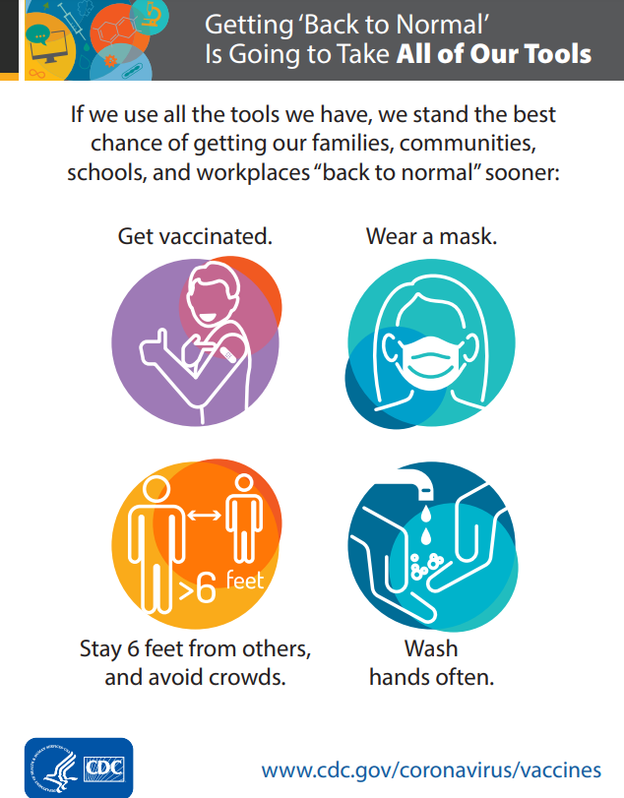
Question
If both residents and families are vaccinated is masking still required for their visits?
Answer:
Yes!
This is a part of the Core Principles of COVID-19 Infection Prevention for Visitation
Face covering or mask (covering mouth and nose)
Instructional signage throughout the facility and proper visitor education on COVID19 signs and symptoms, infection control precautions, other applicable facility practices (e.g., use of face covering or mask, specified entries, exits and routes to designated areas, hand hygiene)
https://www.cms.gov/files/document/qso-20-39-nh.pdf
https://www.cdc.gov/vaccines/covid-19/downloads/all-of-our-tools.pdf

Slide 24
Question
Can children under the age of 18 visit if residents have all been vaccinated and 79% of staff vaccinated and no positive cases
Answer:
Per CMS QSO Memo 20-39-NH on page 3:
“Visitors should be able to adhere to the core principles and staff should provide monitoring for those who may have difficulty adhering to core principles, such as children.”
Core Principles of COVID-19 Infection Prevention for Visitation
Screening of all who enter the facility for signs and symptoms of COVID-19 (e.g., temperature checks, questions or observations about signs or symptoms)
Denial of entry of those with signs or symptoms
Hand hygiene (use of alcohol-based hand rub is preferred)
Face covering or mask (covering mouth and nose)
Social distancing at least six feet between persons
Instructional signage throughout the facility and proper visitor education on COVID19 signs and symptoms, infection control precautions, other applicable facility practices (e.g., use of face covering or mask, specified entries, exits and routes to designated areas, hand hygiene)
Cleaning and disinfecting high frequency touched surfaces in the facility often, and designated visitation areas after each visit
Appropriate staff use of Personal Protective Equipment (PPE)
Effective cohorting of residents (e.g., separate areas dedicated COVID-19 care)
Resident and staff testing conducted as required at 42 CFR 483.80(h) (see QSO-2038-NH)
https://www.cms.gov/files/document/qso-20-39-nh.pdf

Slide 25
Question
I would like to see discussion on who you let visit. Currently, we look at only immediate family. i.e.. children, spouse, parents.
Answer:
There are no specific requirements about who “can” and who “can’t” visit.
“Visitors should be able to adhere to the core principles and staff should provide monitoring for those who may have difficulty adhering to core principles, such as children.”
Facilities should limit the number of visitors per resident at one time and limit the total number of visitors in the facility at one time (based on the size of the building and physical space).
Facilities should consider scheduling visits for a specified length of time to help ensure all residents are able to receive visitors
Other Considerations:
Each facility should develop a limited visitation policy which addresses the following, at minimum:
Visitation schedule, hours, and location.
Number of visitors and visits.
By appointment only, as coordinated by the nursing home, based on their ability to manage infection control practices and proper social distancing.
Each facility must determine its capacity to manage limited visits, based on considerations that include, but are not limited to:
Staff availability to screen visitors;
Monitoring for visitor compliance with safe visitation practices
Disinfection of area between visits.
https://www.cms.gov/files/document/qso-20-39-nh.pdf
https://dhhs.ne.gov/licensure/Documents/LTCCOVID19PhasingGuidance.pdf

Slide 26
Question
What are the guidelines for priests/pastors to come in and visit and/or have mass/services?
Answer:
If a facility is in green, they can invite the priest/pastor to come in to perform a service as a group activity following the Core Principles of COVID-19 Infection Prevention for Visitation
Everyone is masked, residents are spaced/socially distanced in pews/chairs.
Example: a facility is offering assigned days that different halls go to a service.
This helps to keep numbers down in one space
Residents are in every other pew (socially distanced)
Priest/paster comes to them at communion (no lines) and places the host in their hand.
Singing should not happen on a large scale.
The priest/paster would need to be screened before coming into the building just like anyone else.
Priests will come in to do Anointing of the sick as well
Facilities can and have used PPE for this
Again, this depends on facility screening and letting them in as an essential caregiver.
https://www.cms.gov/files/document/qso-20-39-nh.pdf

Slide 27
Question
Is there a plan yet to easily get new residents and staff vaccinated on site?
Answer:
Please reach out to your local health department to develop a plan for vaccinating new residents and staff.
Plans are being developed to collaborate with Long Term Care Pharmacy partners to hold regular vaccine clinics in facilities. We will bring you more info on this as it becomes available.
You may reach out to your local hospital and see if they would be willing to come on site to help with vaccination.

Slide 28
Question
How do employees who have a doctor's note stating they shouldn't have the vaccine factor into our vaccine percentage? Do we have to claim them as declined?
Answer:
Yes, staff that do not receive vaccinations should be counted as a declination. There are specific reasons for declination that should be acknowledged, such as medical and religious exemptions. However, a facilities overall vaccination rate should include all staff in the facility.
Unvaccinated staff can pose risk within the facility and measures to mitigate the risk should be assessed and implemented.

Slide 29
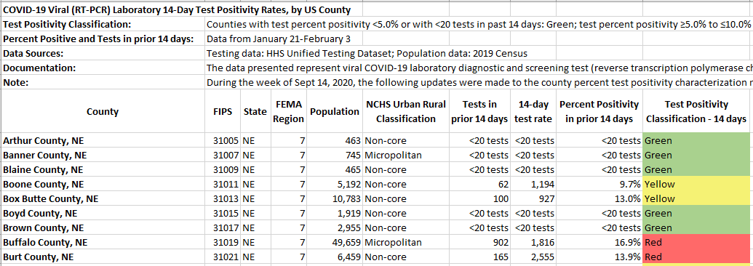
Question
We are an Assisted Living facility in Kearney, NE (Buffalo County), which is a red county per the CMS county positive rate data.
We are 2 weeks post coming out of yellow/red zones during a COVID-19 outbreak, with our last positive case being 1/15/2021.
What is allowed/recommended?
High (>10%): Visitation should only occur for compassionate care situations according to the core COVID-19 Infection Prevention Policies

Slide 30
Question
We are a Skilled nursing facility in Omaha, NE (Douglas County), which is a yellow county per the CMS county positive rate data for the week ending 2/3/2021. For week ending 1/27/2021, Douglas County was red.
What is allowed/recommended for visitation if we are currently in a yellow/red zone in our facility?
**Remember- To allow indoor visitation, there should have been no new onset of COVID-19 cases in the last 14 days and the facility is not currently conducting outbreak testing

Slide 31
Question
We are a Skilled nursing facility in Omaha, NE (Douglas County), which is a yellow county per the CMS county positive rate data for the week ending 2/3/2021. For week ending 1/27/2021, Douglas County was red.
What is allowed/recommended for visitation if we are currently in a green zone in our facility?
The facility is in Green Zone (no current outbreak) and is in a “yellow” county-
Indoor visitation is allowed!

Slide 32
COVID-19 Vaccine Wall of Honor

Slide 33
ICAP COVID-19 Vaccine Wall of Honor!
ICAP wants to celebrate YOU!
You've done the hard work on this COVID-19 journey, and ICAP wants to honor your facilities!
If your facility has vaccinated 70% or more of your staff, we want to know!
Join the ranks of other Long Term Care Facilities in Nebraska as:
Gold: More than 90% vaccinated
Silver: More than 80% vaccinated
Bronze: More than 70% vaccinated
We will include an announcement of new members to the wall of fame on the weekly webinars, as well as feature a facility story on our Facebook page about the facility vaccination journey.
Please submit your facility for the ICAP COVID Wall of Honor at https://forms.gle/DceneS2xABsLMLoQ8

Slide 34
COVID-19 Vaccine Wall of Honor
Bronze Medal Members
Bronze Medal Member by reaching 70% staff COVID-19 vaccination rate
Legacy Square Long-Term Care Facility, Henderson, NE
This Photo by Unknown Author is licensed under CC BY-NC

Slide 35
COVID-19 Vaccine Wall of Honor
Silver Medal Members
Silver Medal Member by reaching 80% staff COVID-19 vaccination rate
Arbor Care Centers Valhaven, Valley, NE
Falls City Care Center, Falls City, NE
Arbor Care Centers Hartington, Hartington, NE
This Photo by Unknown Author is licensed under CC BY-NC
This Photo by Unknown Author is licensed under CC BY-NC-ND

Slide 36
COVID-19 Vaccine Wall of Honor
Gold Medal Members
Gold Medal Member by reaching 90% staff COVID-19 vaccination rate
Wakefield Care Center, Wakefield, NE
Greeley Care Home and Assisted Living, Greeley, NE
Rosewood Court Assisted Living, Henderson , NE
Tabitha in Crete- The Gardens Assisted Living, Crete, NE
This Photo by Unknown Author is licensed under CC BY-NC

Slide 37
Updates and Announcements

Slide 38
COVID-19 Tele-ICAR Reviews
ICAP is offering COVID-19 focused virtual ICAR reviews to LTC, outpatient and acute care facilities
The review will assess the status of COVID-19 policies and procedures and offer a summary of recommendations from ICAP
Home Health Agencies fall under the outpatient umbrella and ICAP has developed a HH focused review to support our HH partners
Contact NE ICAP at 402.552.2881 to be connected with the IP responsible for the facility

Slide 39
Webinar CE Process
1 Nursing Contact Hour and 1 NAB Contact Hour is offered for attending this LIVE webinar
A survey will open upon completion of the webinar, you must complete the survey to get your CE credits. Please note: Your web browser makes a difference. Google Chrome is the suggested browser.
Nursing Credit hours will include the entire month of verified CE on one certificate (Ex: You attended 2 webinars during the month of November, your certificate will reflect the 2 webinar dates and 2 credit hours earned)
Nursing Certificates will be emailed to you by the 15th of the following month
You must have a NAB account to claim credit with them
You must provide your NAB number for us to submit attendance to the NAB system
Direct any CE questions to Marissa Chaney at
machaney@nebraskamed.com

Slide 40
Infection Prevention and Control: Office and On-Call Hours
Call 402-552-2881
Office Hours are Monday – Friday
8:00 AM - 10:00 AM Central Time
2:00 PM - 4:00 PM Central Time
On-Call Hours are
Monday – Friday 4:00 PM – 8:00 PM and
8:00 AM – 8:00 PM Weekends and Holidays
Notes:
An IP will take calls on Christmas Eve and Christmas Day, but staffing is limited during this time. Please reach out proactively using this number if your facility is experiencing a new outbreak. The usual data channels for receiving COVID-19 case info will be limited to ICAP during this time.

Slide 41
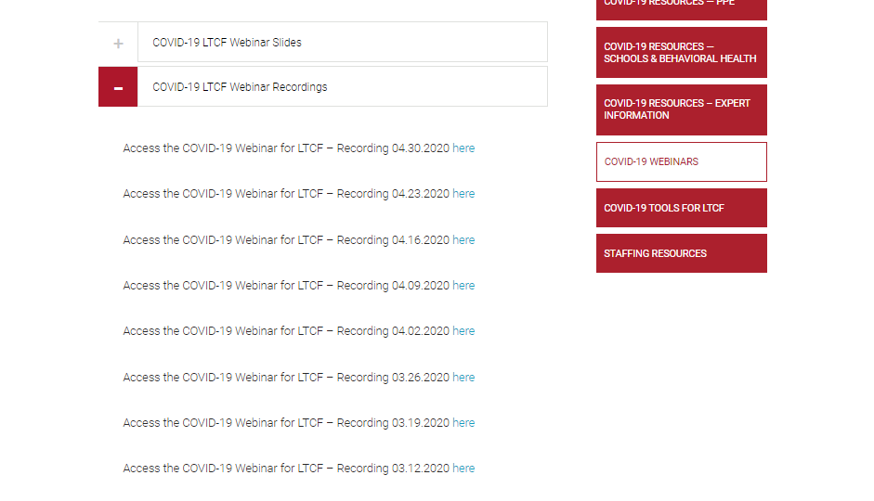
Questions and Answer Session
Use the QA box in the webinar platform to type a question. Questions will be read aloud by the moderator.
Panelists:
Dr. Salman Ashraf
Kate Tyner, RN, BSN, CIC
Margaret Drake, MT(ASCP),CIC
Sarah Stream, MPH, CDA, FADAA
Karen Amsberry, MSN, RN
Lacey Pavlovsky, RN, MSN, CIC
Dan German
Becky Wisell
Dan Taylor
Moderated by Marissa Chaney
Supported by Margaret Deacy
Slide support from Lacey Pavlovsky, RN, MSN, CIC
https://icap.nebraskamed.com/resources/
Don’t forget to Like us on Facebook for important updates!

