Slide 1
Benchmarking Dialysis Bloodstream Infections: A Mini Educational Overview on Standardized Infection Ratio "SIR"
Educational Training Presentation Provided by
Nebraska ICAP
Notes:
The following presentation was prepared to allow the facilitator to utilize the written script alongside the slides. Facilitators may choose to follow the script while presenting or deliver the content independently if they are familiar with the material.
The facilitator may choose to review the material with staff and take questions during the presentation or at the end.
Once the presentation is opened in presentation mode, the script will appear alongside the slides.

Slide 2
These slides were developed by Nebraska ICAP for the purposes of quality improvement and education. They may be modified to incorporate your organization's logo or design for local use. However, changes to the educational content itself are not within the intended scope of this course and are discouraged, as they may alter the integrity and accuracy of the material presented.

Slide 3

Benchmarking
Benchmarking is a way for businesses, schools, or hospitals to compare what they’re doing with others or with their own past results.
It helps them see if they’re doing great, need to improve, or if they’re staying the same.
Notes:
Do you ever wonder how your facility compares to other facilities when it comes to taking care of your patients and preventing infections?
You are not alone.
A process called benchmarking is a process that compares your facility to other facilities that perform similar activities and services, such as dialysis.
Example (or make your own up)
Imagine you and your friends take a math test. After grading, the teacher says:
The average score for the whole class is 80 points.
Your score is 85 points—that means you did better than most! 🎉
Another friend got 75 points, so they might want to study a little more next time. 📚
Hospitals do the same thing with infections and patient care. They compare their numbers to other hospitals to see if they are doing:
Better than most (great job! ✅)
Worse than most (needs improvement! ❌)
About the same (keep up the good work! 👍)
By comparing numbers, hospitals can learn from the best ones and find ways to get better at keeping patients safe. 😊

Slide 4

What infections are tracked in NHSN?
National Healthcare Safety Network is a CDC program that collects and analyzes data to help facilities to prevent and eliminate infections.
Bloodstream infection (BSI): Any positive blood culture event.
Access-related bloodstream infection (ARBSI): Positive blood culture with the suspected source reported as the vascular access or uncertain.
Local access site infection (LASI): Pus, redness, or increased swelling of the vascular access site and access-related bloodstream infection is not present.
Vascular access infection (VAI): Either a local access site infection or an access-related bloodstream infection.
Notes:
Dialysis centers in the U.S. track certain types of infections to improve patient safety. There are four types of infections reported to the National Healthcare Safety Network (NHSN), and each is measured using a statistic called the Standardized Infection Ratio (SIR).
As we review each infection type, think about which one would be the best benchmark for your facility. This can be discussed with your team.
The Four Infection Types:
Bloodstream Infections (BSIs):
These are serious infections where bacteria enter the blood, sometimes from dialysis access sites (like catheters or grafts), or from other sources like wounds. This type includes all BSIs, even those not caused by dialysis care, so they may not fully reflect your facility’s performance.
Access-Related Bloodstream Infections (AR-BSIs):
These are BSIs that are clearly linked to dialysis access. Tracking AR-BSIs helps show how well your facility prevents infections directly related to treatment.. I usually recommend AR-BSI as the best to benchmark, because it focuses on what your team can control and may be the better infection to track.
Local Access Site Infections (LASIs):These are signs of infection (like redness or pus) around the dialysis access site, but excludes AR-BSI.
Vascular Access Infections (VAIs):
This is a broader category that includes both LASIs and AR-BSIs.

Slide 5

SIR: But What Does It Mean
The Standardized Infection Ratio (SIR) is a way to measure if we have more or fewer infections than expected.
If it’s lower than 1, we have fewer infections than expected.
Checking this number every few months helps us see if we’re getting better, staying the same, or getting worse at preventing infections.
If the number is higher than 1, we have more infections than we should.
Notes:
The Standardized Infection Ratio (SIR) compares the number of infections your facility actually had to the number that was predicted, based on national data from NHSN. This prediction adjusts for key factors, such as patient population and facility characteristics, to ensure a fair comparison.
By tracking your access-related bloodstream infection (BSI) SIR by quarter, you can identify trends over time, seeing whether your infection rates are staying stable, getting better, or getting worse.
What does the number mean?
An SIR above 1 means more infections occurred than expected.
An SIR below 1 means fewer infections occurred than expected.
Think of 1.00 as the comparison point, not necessarily a “goal.” The aim should always be to stay below 1 if possible, because that reflects fewer infections than predicted.
It's important to review values periodically and identify trends that can help you put isolated spikes or outliers in perspective and focus on long-term progress.
Using the NHSN SIR allows your facility to compare performance to other outpatient dialysis facilities across the country. NHSN has already done the complex statistical work to make this possible, pulling data from all participating centers and adjusting for key differences to allow meaningful comparisons.

Slide 6







Expected Infections???
What Are Expected Infections in NHSN?
Expected infections represent the number of infections that would be anticipated in a healthcare facility based on national baseline data.
This is derived from historical data on HAIs collected across numerous facilities, adjusted for factors such as:
  Facility type (e.g., rural, tribal, non-profit, affiliation with hospital or corporation)
  Patient characteristics (e.g., age, underlying conditions)
  Vascular Access Type
  Patient Census
  Quality of Data Entered
Notes:
Okay! Imagine you have a big jar of jellybeans, and you know from past years that if you shake the jar a certain way, about 10 jellybeans usually fall out. That’s what you expect to happen based on past experience.
Now, let’s say you shake the jar today, and 12 jellybeans fall out. That’s more than expected! Or maybe only 8 jellybeans fall out—less than expected.
In hospitals, doctors and nurses track infections kind of like that. They look at past data to predict how many infections should happen based on things like how many patients they have, how sick the patients are, and what medical tools they use. This is called expected infections.
Then, they compare it to the actual number of infections that happen.
If the actual number is higher than expected, the hospital might need to find out why and fix the problem.
If it’s lower than expected, that’s great—it means they’re doing a good job keeping infections away!
Hospitals use this system to keep patients safe and work on making healthcare better.

Slide 7

How Are Expected Infections Calculated?
NHSN uses risk models based on past HAI data to predict the number of infections expected in a specific facility.
These models consider variables like:
  Vascular Access Type days [for infections like AR-BSI (Access-Related Blood Stream Infections)]
  Facility characteristics (Number of chairs, rural, tribal, non-profit, etc.)
  Facility Exclusions:
    Facilities that do not offer in-center hemodialysis.
    Facilities that treat fewer than 11 in-center hemodialysis patients during the performance period.
    Facilities with approved Extraordinary Circumstances Exception (ECE).
Notes:
NHSN tracks access-related bloodstream infections (ARBSIs) in dialysis patients by looking at how infections happen based on the type of access used for treatment. Here’s a simple breakdown of how they calculate it:
Dialysis centers report all blood stream infections, and the type(s) of dialysis accesses their patients have.
Look at the Risk Not all dialysis access types have the same risk. Catheters have a higher chance of infection than fistulas or grafts. NHSN will adjusts for this by considering the type of access the patient had.
They compare the actual infections to the expected infections to see if the rate is higher or lower than normal.
Calculate the Infection Rate
They use a formula to find out how often infections happen per 1,000 dialysis sessions (to keep the numbers fair across different centers).
The result helps clinics see if they have more, fewer, or about the same infections as expected.
This helps dialysis centers improve safety by finding ways to lower infection risks, like by auditing their compliance practices on accessing and deaccessing vascular access sites, hand hygiene, and disinfection practices to determine if there are any gaps in practices.

Slide 8
Review: Putting your new skills to the test
Notes:
The next few slides go through examples of how to compare SIR values between different facilities. The data used in the examples was made up for the purpose of educational use and does not reflect any facility data. Any similarities is purely coincidental.
You may do as many examples as you want.

Slide 9
Scenario #1: Which facility did better?
SIR 0.79
SIR 1.87
Census: 160
Expected Infections: 5.08
Observed Infections: 4
Census: 44
Expected Infections: 2.25
Observed Infections: 4
A
B
Notes:
Before starting with the script, allow staff a couple of minutes to review the slide and discuss the information they see on the slide.
Facility A is larger with an expected infection number or count of 5.09 vs facility B who is much smaller with a much lower expected infection number or count of 2.15.
Both facilities had the same number of infections, 4. but Facility A performed better. Why?
Facility A had 4 infections and had a SIR of 0.79, which is below 1.00 which shows that the facility is performing above average.
Facility B also had 4 infections, but their SIR was 1.87, which is higher than 1.00. This facility has more infections than is expected for a facility of their size and patient demographics.
Point: The same number of infections in each facility does not mean they performed the same.

Slide 10
Scenario #2: Which facility did better?
SIR 0.77
SIR 0.77
Census: 157
Expected Infections: 8.14
Observed Infections: 6
Census: 72
Expected Infections: 2.12
Observed Infections: 2
C
D
Notes:
These facilities have identical SIRs, so they performed the same, even though one facility had 6 infections, and the other one had 2 infections.
Point: This is how NHSN can use their formulas to calculate infection risk. (Remember when we discussed how dialysis uses 1,000 dialysis sessions)? It keeps the numbers comparable across different centers. This way facilities can compare themselves to other facilities, even though they are different sizes and have different types of patients.
(Refer to slide 6 if needed)
Both have an SIR of 0.77, which is below 1.00, meaning they both had less infections than expected.
Way to go. Does that mean they do not need to improve?
The goal of any quality improvement program is to make continuous improvements. Zero infections are possible.

Slide 11
Which facility did better?
SIR 0.45
SIR 0.79
Census: 181
Expected Infections: 9.11
Observed Infections: 4
Census: 149
Expected Infections: 5.08
Observed Infections: 4
B
C
Notes:
Facility B performed better than Facility C, though both facilities had the same number of infections.
Both facilities performed well with SIRs below 1.00. Both facilities had fewer infections than expected.
Point: To reinforce how NHSNs’ formula works to compare facilities of different sizes to each other.
What if Facility B had an SIR of 0.35 the previous year with 3 infections?
They did not improve. Should they be concerned?
An SIR of 0.45 is still below 1.00, which is less than expected. But the infection rate is increasing, so the facility would want to investigate why the infections occurred.
Drill down on each individual infection to determine possible causes.
Increase auditing of staff infection prevention and control practices. (i.e., vascular access care, access/deaccess practices, injection practices, hand hygiene, cleaning and disinfection).

Slide 12
Scenario #3: Which facility did better?
SIR 0.45
Census: 181
Expected Infections: 8.21
Observed Infections: 4
SIR 0.79
Census: 160
Expected Infections: 5.08
Observed Infections: 4
A
E
Notes:
Now, looking at the same Facility A with Facility E.
Facility E performed better than Facility A, though both facilities had the same number of infections.
Both facilities performed well with SIRs below 1.00. Both facilities had fewer infections than expected.
Point: To reinforce how NHSNs’ formula works to compare facilities of different sizes to each other.
What if Facility E had an SIR of 0.35 the previous year with 3 infections?
They did not improve. Should they be concerned?
A SIR of 0.45 is still below 1.00, which is less than expected. But the infection rate is increasing, so the facility would want to investigate why the infections occurred.
Drill down on each individual infection to determine possible causes.
Increase auditing of staff infection prevention and control practices. (i.e., vascular access care, access/deaccess practices, injection practices, hand hygiene, cleaning and disinfection).

Slide 13

What are the similarities?
What are the differences?
Which facility performed the best?
Which facility performed the worst?
Do any of them need to improve?
SIR 0.45
SIR 0.79
1.85
Census: 183
Expected Infections: 8.23
Observed Infections: 4
SIR 1.87
Census: 151
Expected Infections: 6.01
Observed Infections: 4
Census: 65
Expected Infections: 2.24
Observed Infections: 4
Census: 42
Expected Infections: 2.25
Observed Infections: 4
E
A
F
B
Notes:
Comparing facilities of various sizes to each other.
What do you think about the SIRs?
Any similarities?
The smaller facilities have similar expected infections, they all had the same number of infections: 4.
Any differences?
Even though they had they same number of infections, they all had different SIRs.
Which facility performed the best?
Facility E had the lowest SIR. We do not know how these facilities performed in prior performance periods. It may be possible that Facility F had an SIR of 3.00 prior to the SIR of 1.85 and Facility A had a SIR of 0.78. How would that change the outlook?
Which facility performed the worst?
Do any of the facilities need to improve?
Facilities can assess their SIR in NHSN monthly or quarterly to monitor how they are doing.

Slide 14
SIRs Greater Than 1.00
1.85
SIR 1.87
Census: 65
Expected Infections: 2.24
Observed Infections: 4
Census: 47
Expected Infections: 2.19
Observed Infections: 4
Did these facilities perform poorly?
What if they had 6 infections the year before with a SIR above 2.0?
Now how did they perform?
Do they need to improve?
F
B
Notes:
A SIR greater than 1 is not necessarily a failure, it’s a starting point for assessing opportunities for improvement.
The purpose of this slide is to show that even SIRs above expected (greater than 1) can be positive and no one should be discouraged if the SIR is an improvement. The goal is to show improvement over time. Decreasing SIRs shows that the facility has put in processes to prevent infections that are working.
Consider a facility, F, with a Standardized Infection Ratio (SIR) of 1.85 and 4 infections. After increasing their audits, they discover a gap in staff practices regarding the use of central lines. Specifically, staff are not waiting the recommended 15 seconds for the 70% alcohol disinfectant to dry after scrubbing the hub. In response, the facility provides education to staff and increases monitoring. The following year, the facility reports 3 infections, with an improved SIR of 1.23.
The SIR also helps to adjust for changes in a facility such as an increase or decrease in census, allowing a facility to show trends over a period.
A facility can have an SIR of 0.57 one year, then have an SIR of 0.98 the following year. Both are below 1.00, which is less than expected, but they still had an increase in infections which is a cause for concern.

Slide 15
Showing Progress over time
Improvement matters more than a perfect score!
Notes:
Key Takeaway
Don’t focus solely on whether the SIR is above or below 1.0.
Focus on:
Trends over time
Actions taken to reduce infection risk
Continuous improvement
Even when the SIR is greater than 1.0, a decreasing trend shows progress and that interventions are making a difference.
Improvement matters more than having a perfect score, and recognize that even SIRs above 1.0 can reflect progress:

Slide 16
SIR 0.77
SIR 0.78
SIR 0.77
Census: 169
Expected Infections: 8.14
Observed Infections: 6
SIR 0.79
Census: 118
Expected Infections: 3.07
Observed Infections: 3
Census: 71
Expected Infections: 2.01
Observed Infections: 2
Census: 263
Expected Infections: 10.02
Observed Infections: 8
Notice any similarities?
Do you notice any differences?
Which facility performed the best?
Which facility performed the worst?
Do any of them need to improve?
B
A
D
C
Notes:
Which facility performed better?
Can you compare facilities of different sizes to each other?
Since the SIR is below 1, the facilities all performed better than expected, but they still have infections and should strive to improve every year. By monitoring the SIR throughout the year, it allows a facility to see how they are doing. If their rates start to increase, then the facility can start the process of drilling down to see if there are any processes (i.e., hand hygiene, cleaning & disinfection, etc.) they may need to work on. Auditing practices can be key to staying on top of facility practices.

Slide 17
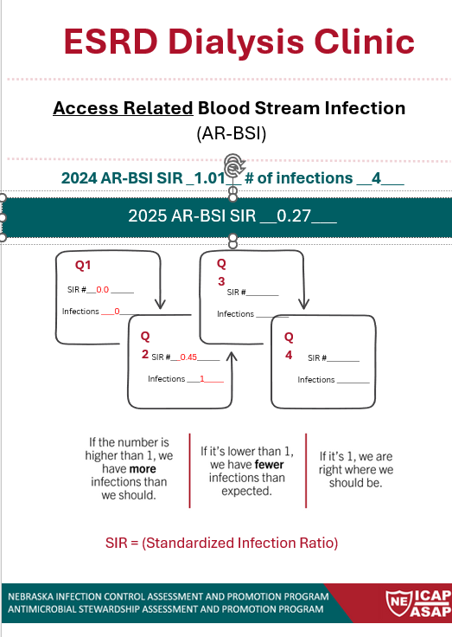
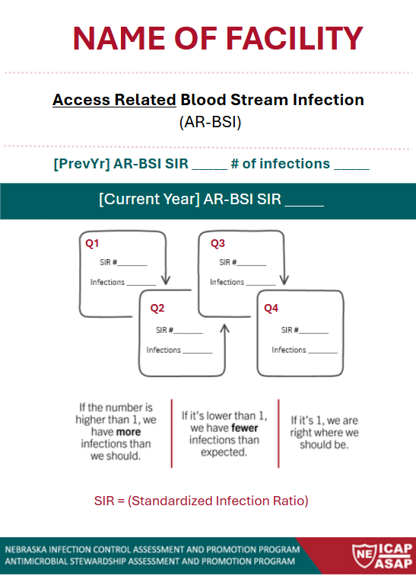
Fillable Tracking Display Poster
Enter previous year information here
Update with most recent SIR
Update infection information every 3 months
Notes:
This is a downloadable poster to assist facilities in tracking and trending their facility SIR.
Facilities can fill in their own name and facility information and post in a location to share with staff.
The first poster is an example with some of the information filled in with fake facility information.
The smaller version is what the poster looks like when it is downloaded before you enter your information into it.

